Slide 1
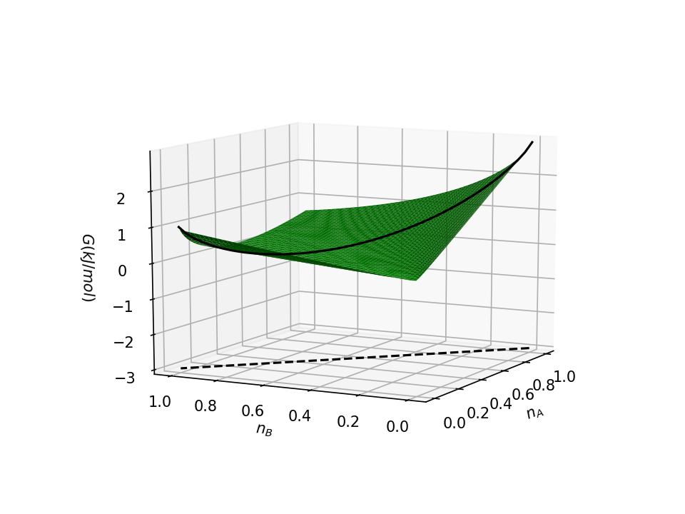
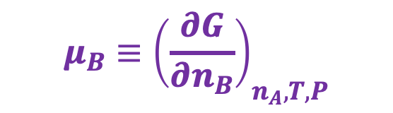
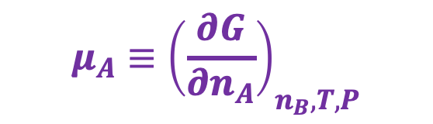
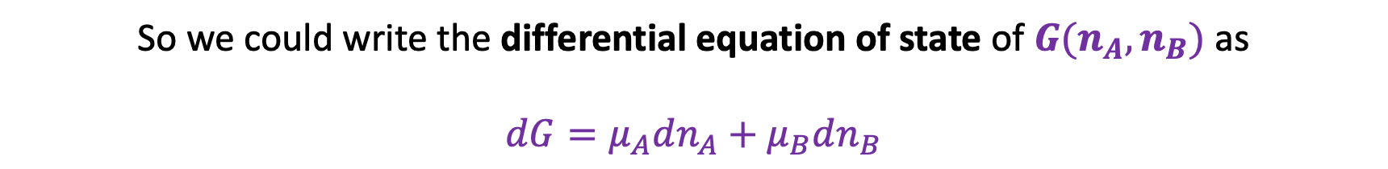
Chemical potentials – they’re just slopes in the $n_{A}$, $n_{B}$ state space
$$μ_{B}≡{\left(\frac{∂G}{∂n_{B}}\right)}_{n_{A}, T,P}$$
$$G(n_{A},n_{B})$$
$$μ_{A}≡{\left(\frac{∂G}{∂n_{A}}\right)}_{n_{B}, T,P}$$
So we could write the differential equation of state of $G(n_{A},n_{B})$ as
$$dG=μ_{A}dn_{A}+μ_{B}dn_{B}$$

Slide 2

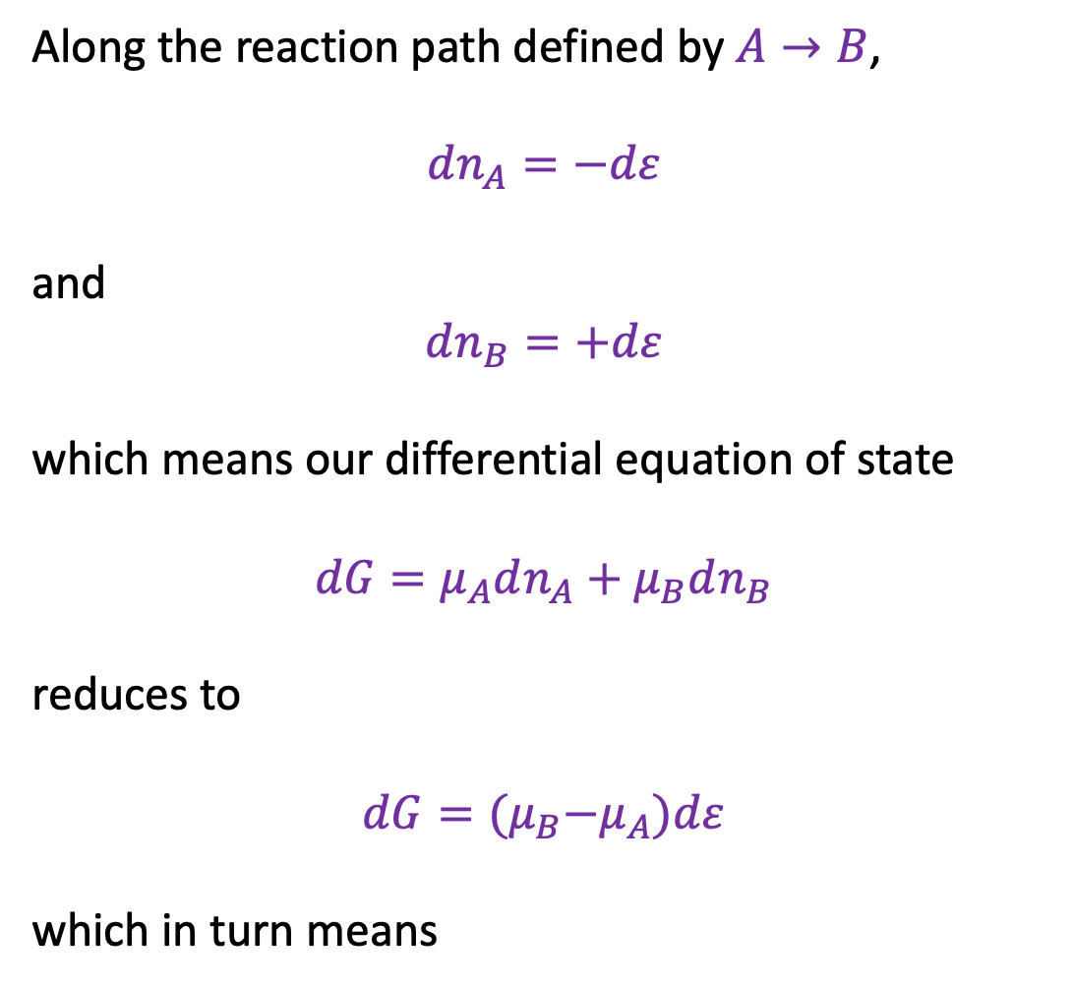

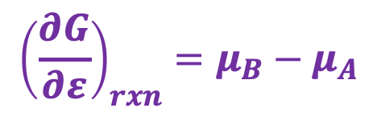
Chemical potentials along a reaction path
Along the reaction path defined by $A→B$,
$dn_{A}=−dε$
and
$$dn_{B}=+dε$$
which means our differential equation of state
$$dG=μ_{A}dn_{A}+μ_{B}dn_{B}$$
reduces to
$$dG={(μ}_{B}−μ_{A})dε$$
which in turn means
$$dn_{A}$$
$$dn_{B}$$
$${\left(\frac{∂G}{∂ε}\right)}_{rxn}=μ_{B}−μ_{A}$$

Slide 3

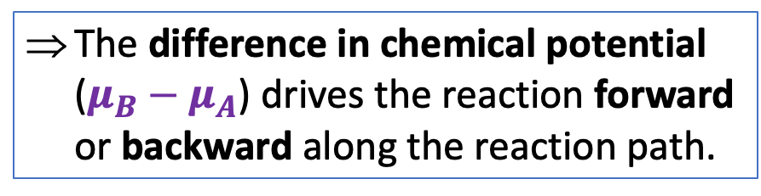
Chemical potentials along a reaction path
Along the reaction path defined by $A→B$,
$dn_{A}=−dε$
and
$$dn_{B}=+dε$$
which means our differential equation of state
$$dG=μ_{A}dn_{A}+μ_{B}dn_{B}$$
reduces to
$$dG={(μ}_{B}−μ_{A})dε$$
which in turn means
$$dn_{A}$$
$$dn_{B}$$
The difference in chemical potential ($μ_{B}−μ_{A}$) drives the reaction forward or backward along the reaction path.
$${\left(\frac{∂G}{∂ε}\right)}_{rxn}=μ_{B}−μ_{A}$$

Slide 4
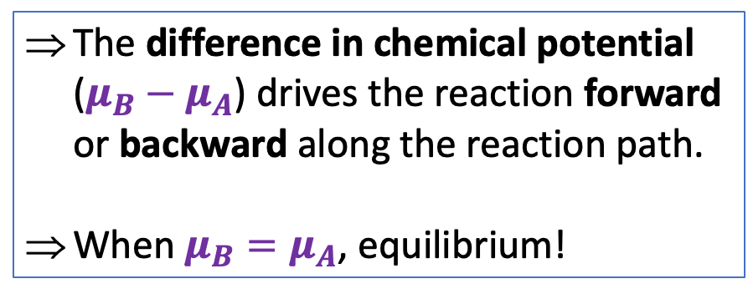
Chemical potentials along a reaction path
Along the reaction path defined by $A→B$,
$dn_{A}=−dε$
and
$$dn_{B}=+dε$$
which means our differential equation of state
$$dG=μ_{A}dn_{A}+μ_{B}dn_{B}$$
reduces to
$$dG={(μ}_{B}−μ_{A})dε$$
which in turn means
$$dn_{A}$$
$$dn_{B}$$
The difference in chemical potential ($μ_{B}−μ_{A}$) drives the reaction forward or backward along the reaction path.
When $μ_{B}=μ_{A}$, equilibrium!
$${\left(\frac{∂G}{∂ε}\right)}_{rxn}=μ_{B}−μ_{A}$$

Slide 5
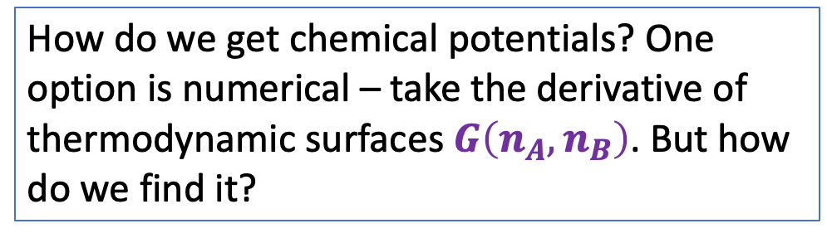
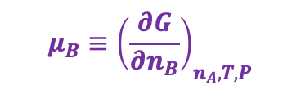
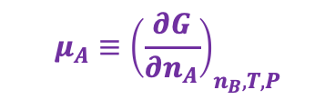
Finding chemical potentials numerically
$$μ_{B}≡{\left(\frac{∂G}{∂n_{B}}\right)}_{n_{A}, T,P}$$
How do we get chemical potentials? One option is numerical – take the derivative of thermodynamic surfaces $G\left(n_{A},n_{B}\right)$. But how do we find it?
$$G(n_{A},n_{B})$$
$$μ_{A}≡{\left(\frac{∂G}{∂n_{A}}\right)}_{n_{B}, T,P}$$

Slide 6
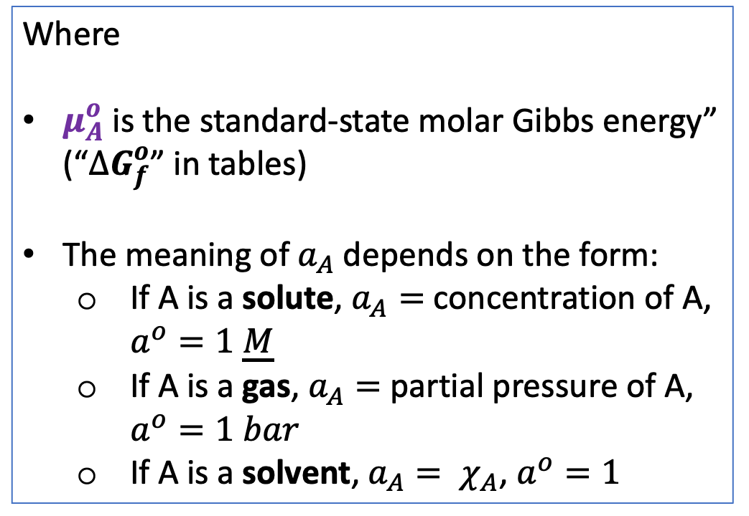
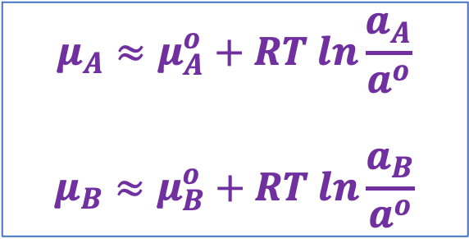
Calculating chemical potentials with the CPF
$$μ_{A}≈μ_{A}^{o}+RT ln\frac{a_{A}}{a^{o}}$$
$$μ_{B}≈μ_{B}^{o}+RT ln\frac{a_{B}}{a^{o}}$$
An analytical formula for the chemical potential: the CPF:
(We’ll derive this Friday, of course)
Where
$μ_{A}^{o}$ is the standard-state molar Gibbs energy” (“${∆G}_{f}^{o}$” in tables)
The meaning of $a_{A}$ depends on the form:
If A is a solute, $a_{A}=$ concentration of A, $a^{o}=1 \underline{M}$
If A is a gas, $a_{A}=$ partial pressure of A, $a^{o}=1 bar$
If A is a solvent, $a_{A}= χ_{A}$, $a^{o}=1$
$$μ_{B}≡{\left(\frac{∂G}{∂n_{B}}\right)}_{n_{A}, T,P}$$
$$G(n_{A},n_{B})$$
$$μ_{A}≡{\left(\frac{∂G}{∂n_{A}}\right)}_{n_{B}, T,P}$$

Slide 7

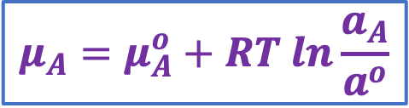



Intuitive use of the CPF (solutes)
$$μ_{A}=μ_{A}^{o}+RT ln\frac{a_{A}}{a^{o}}$$
X
Y
A(aq)
Chamber X: Solute A is highly concentrated
Chamber Y: Solute A is less concentrated
A(aq)
A(aq)
A(aq)
In which chamber does aqueous A have the higher chemical potential, X or Y?
Chemical potential
$$μ_{A}\left(X\right)$$
$$μ_{A}\left(Y\right)$$
or
$$μ_{A}\left(Y\right)$$
$$μ_{A}\left(X\right)$$

Slide 8
Intuitive use of the CPF (solutes)
$$μ_{A}=μ_{A}^{o}+RT ln\frac{a_{A}}{a^{o}}$$
X
Y
A(aq)
Chamber X: Solute A is highly concentrated
Chamber Y: Solute A is less concentrated
A(aq)
A(aq)
A(aq)
In which chamber does aqueous A have the higher chemical potential, X or Y?
Chemical potential
$$μ_{A}\left(X\right)$$
$$μ_{A}\left(Y\right)$$
or
$$μ_{A}\left(Y\right)$$
$$μ_{A}\left(X\right)$$

Slide 9
Intuitive use of the CPF (solutes)
$$μ_{A}=μ_{A}^{o}+RT ln\frac{a_{A}}{a^{o}}$$
X
Y
A(aq)
A moves from higher chemical potential to lower chemical potential
Chamber X: Solute A is highly concentrated
Chamber Y: Solute A is less concentrated
A(aq)
A(aq)
A(aq)
In which chamber does aqueous A have the higher chemical potential, X or Y?
Chemical potential
$$μ_{A}\left(X\right)$$
$$μ_{A}\left(Y\right)$$
or
$$μ_{A}\left(Y\right)$$
$$μ_{A}\left(X\right)$$

Slide 10

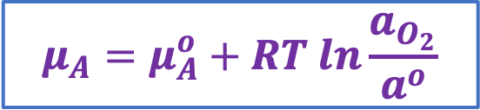



Intuitive use of the CPF (gases)
$$μ_{A}=μ_{A}^{o}+RT ln\frac{a_{O_{2}}}{a^{o}}$$
X
Y
Chamber X: Pressure of O₂(g) is 1 atm
Chamber Y: Partial pressure is 0.21 atm
Pure O₂(g)
1 atm
Air
21% O₂(g)
In which chamber does O₂(g) have the higher chemical potential, X or Y?
Chemical potential
$$μ_{O_{2}}\left(X\right)$$
$$μ_{O_{2}}\left(Y\right)$$
or
$$μ_{O_{2}}\left(Y\right)$$
$$μ_{O_{2}}\left(X\right)$$

Slide 11
Intuitive use of the CPF (gases)
$$μ_{A}=μ_{A}^{o}+RT ln\frac{a_{O_{2}}}{a^{o}}$$
X
Y
O₂ moves from higher chemical potential to lower chemical potential
Chamber X: Pressure of O₂(g) is 1 atm
Chamber Y: Partial pressure is 0.21 atm
Pure O₂(g)
1 atm
Air
21% O₂(g)
In which chamber does O₂(g) have the higher chemical potential, X or Y?
Chemical potential
$$μ_{O_{2}}\left(X\right)$$
$$μ_{O_{2}}\left(Y\right)$$
or
$$μ_{O_{2}}\left(Y\right)$$
$$μ_{O_{2}}\left(X\right)$$

Slide 12


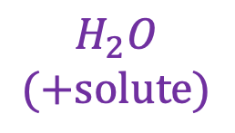


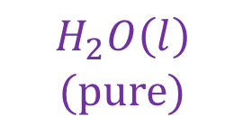
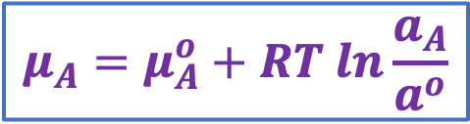
Intuitive use of the CPF (solvents)
Chamber X is a 1 M solution of NaCl(aq). Chamber Y is pure water.
1. Which is correct?
X
Y
$$μ_{H_{2}O}\left(X\right)$$
$$μ_{H_{2}O}\left(Y\right)$$
$$H_{2}O$$
$$(+solute)$$
$$H_{2}O\left(l\right)$$
$$(pure)$$
$$μ_{H_{2}O}\left(Y\right)$$
$$μ_{H_{2}O}\left(X\right)$$
$$μ_{A}=μ_{A}^{o}+RT ln\frac{a_{A}}{a^{o}}$$

Slide 13
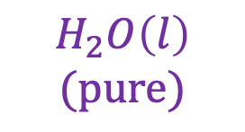





Intuitive use of the CPF (solvents)
Chamber X is a 1 M solution of NaCl(aq). Chamber Y is pure water.
1. Which is correct?
X
Y
$$μ_{H_{2}O}\left(X\right)$$
$$μ_{H_{2}O}\left(Y\right)$$
$$H_{2}O$$
$$(+solute)$$
$$H_{2}O\left(l\right)$$
$$(pure)$$
$$μ_{H_{2}O}\left(Y\right)$$
$$μ_{H_{2}O}\left(X\right)$$
$$μ_{A}=μ_{A}^{o}+RT ln\frac{a_{A}}{a^{o}}$$

Slide 14
Intuitive use of the CPF (solvents)
Chamber X is a 1 M solution of NaCl(aq). Chamber Y is pure water.
1. Which is correct?
X
Y
$$μ_{H_{2}O}\left(X\right)$$
$$μ_{H_{2}O}\left(Y\right)$$
$$H_{2}O$$
$$(+solute)$$
$$H_{2}O\left(l\right)$$
$$(pure)$$
$$μ_{H_{2}O}\left(Y\right)$$
$$μ_{H_{2}O}\left(X\right)$$
$$μ_{A}=μ_{A}^{o}+RT ln\frac{a_{A}}{a^{o}}$$

Slide 15

Intuitive use of the CPF (solvents)
Chamber X is a 1 M solution of NaCl(aq). Chamber Y is pure water.
1. Which is correct?
X
Y
$$μ_{H_{2}O}\left(X\right)$$
$$μ_{H_{2}O}\left(Y\right)$$
$$H_{2}O$$
$$(+solute)$$
$$H_{2}O\left(l\right)$$
$$(pure)$$
$$μ_{H_{2}O}\left(Y\right)$$
$$μ_{H_{2}O}\left(X\right)$$
Water spontaneously moves from the pure side to the side with solute!
$$μ_{A}=μ_{A}^{o}+RT ln\frac{a_{A}}{a^{o}}$$

Slide 16
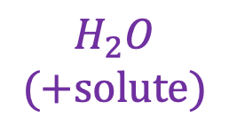
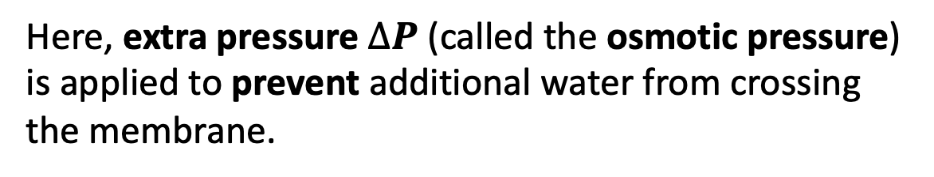


Intuitive use of the CPF (solvents)
X
Y
$$∆P$$
Here, extra pressure $∆P$ (called the osmotic pressure) is applied to prevent additional water from crossing the membrane.
$$H_{2}O$$
$$(+solute)$$
$$H_{2}O\left(l\right)$$
$$(pure)$$

Slide 17
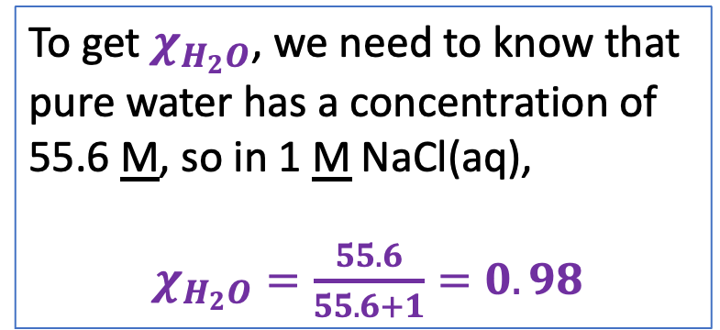
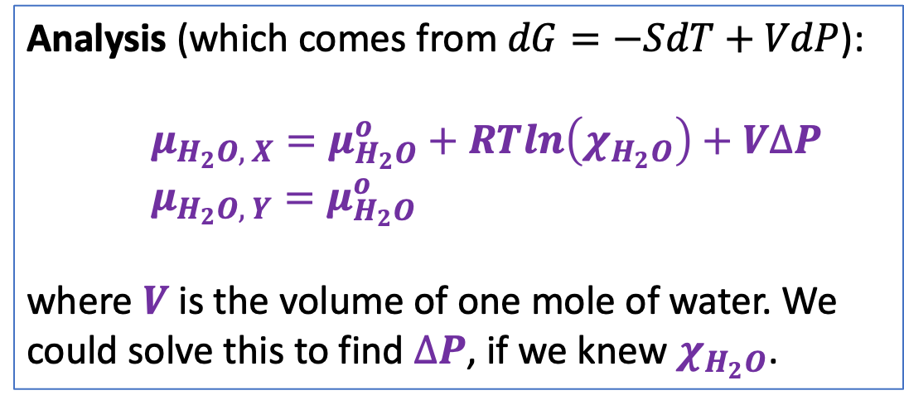
Intuitive use of the CPF (solvents)
X
Y
$$∆P$$
Here, extra pressure $∆P$ (called the osmotic pressure) is applied to prevent additional water from crossing the membrane.
$$H_{2}O$$
$$(+solute)$$
$$H_{2}O\left(l\right)$$
$$(pure)$$
Analysis (which comes from $dG=−SdT+VdP$):
$μ_{H_{2}O, X}=μ_{H_{2}O}^{o}+RTln\left(χ_{H_{2}O}\right)+V∆P$
$μ_{H_{2}O, Y}=μ_{H_{2}O}^{o}$
where $V$ is the volume of one mole of water. We could solve this to find $∆P$, if we knew $χ_{H_{2}O}$.
To get $χ_{H_{2}O}$, we need to know that pure water has a concentration of 55.6 M, so in 1 M NaCl(aq),
$χ_{H_{2}O}=\frac{55.6}{55.6+1}=0.98$

